Slide 1
Machine Learning with WEKA
Duy Pham, Daniel Esparza

Slide 2
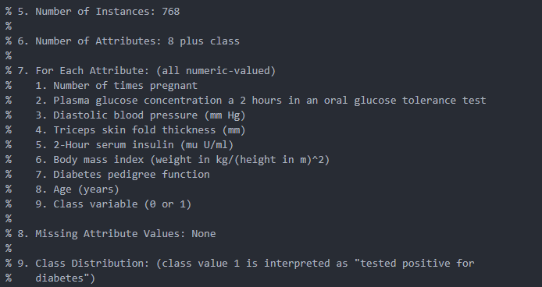
.arff file could be open with text editor for more information.

Slide 3
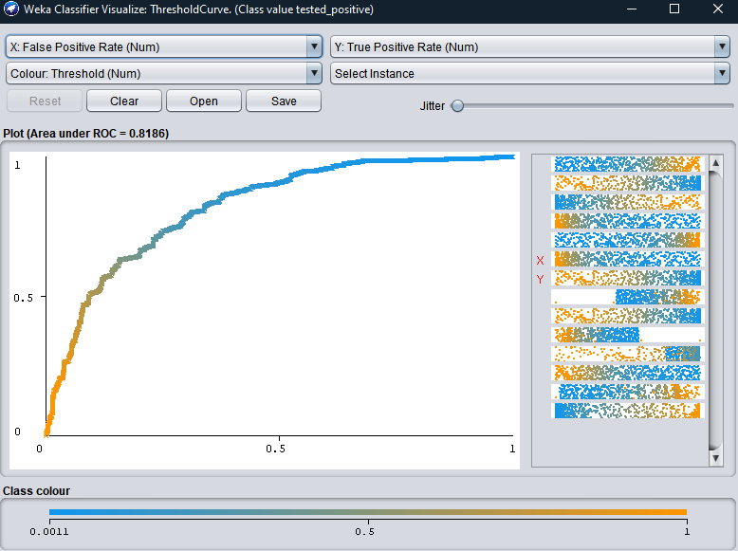
ROC
A Receiver Operator Characteristic (ROC) curve is a graphical plot used to show the diagnostic ability of binary classifiers.
Classifiers that give curves closer to the top-left corner indicate a better performance.

Slide 4
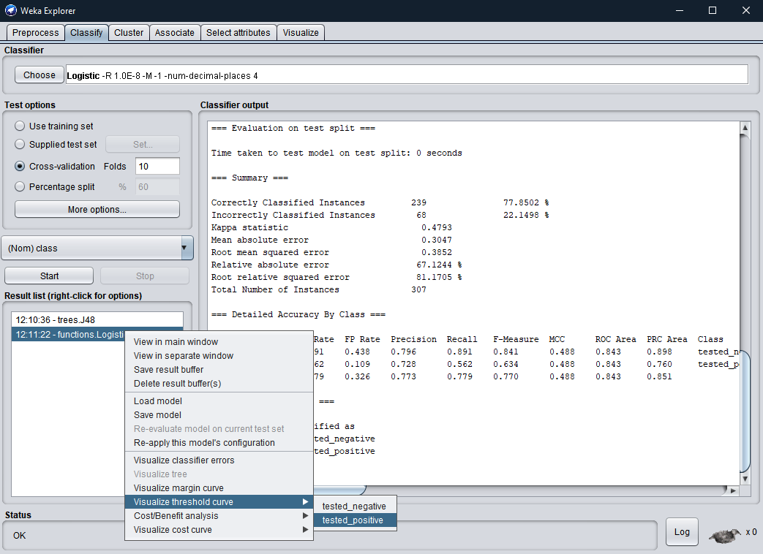
The curve and under
A ROC curve is constructed by plotting the true positive rate (Y) against the false positive rate (X).
To compare different classifiers’ performance we can use AUC(Area under curve)

Slide 5
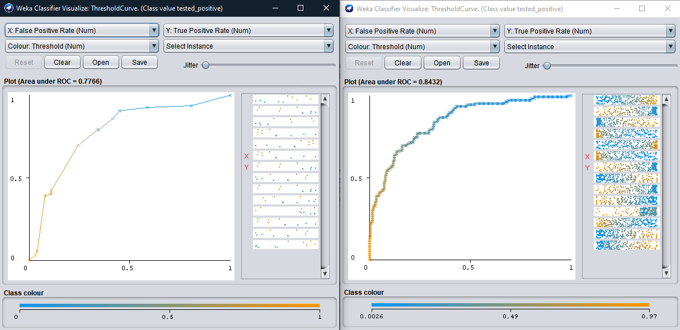
Classifier: Tree J48 vs Logistic
The AUCs greater = better
77%
84%
When you plot a random point the percentage of it under the ROC is higher

Slide 6
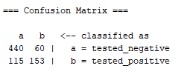

Confusion Matrix
Training with cross-validation; logistic classifier Training with percentage split: 60; logistic classifier
Only use 40% of the data for testing
Total number of element in both class for testing. (768 instances)
Number of elements in class b INCORRECTLY classified as class a
Number of elements in class a classified as (tested_negative) class a

Slide 7
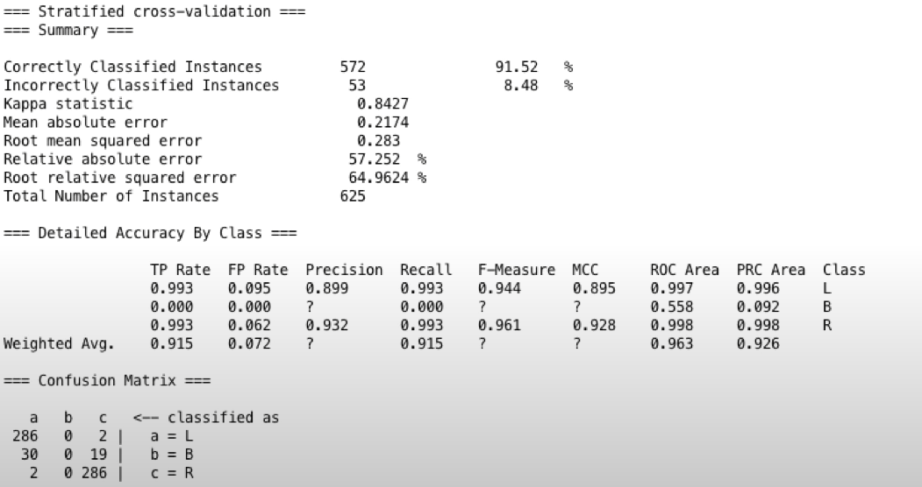
Good model?
Great percentage
Very good classified between a and c BUT nothing get classified as b including element of b.
Good AUC

Slide 8
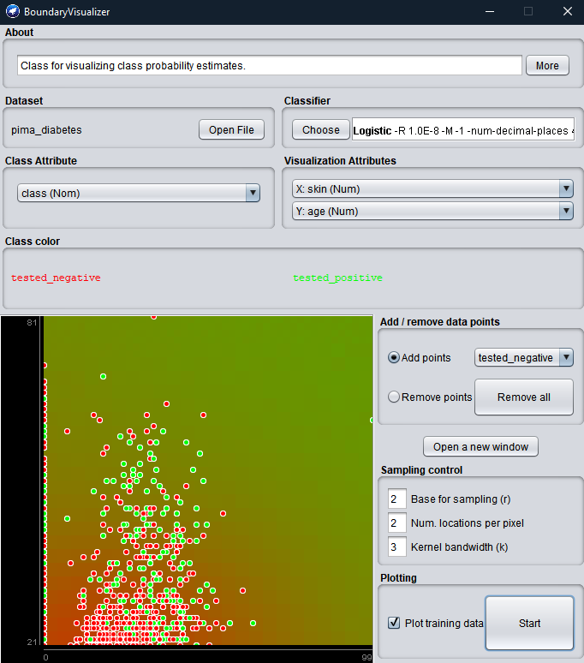
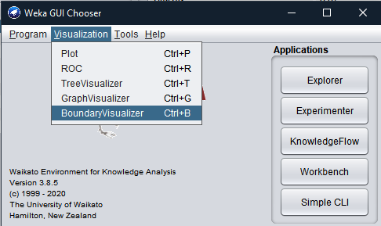
Boundary Visualization window

Slide 9
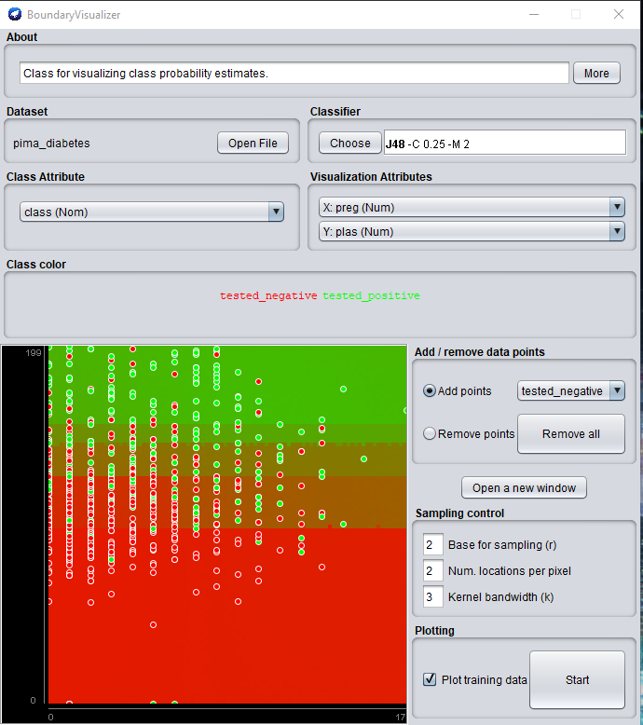
Classification Boundary
Classification boundaries are boundaries that categorize which data sets should belong to specific classes
Using the Visualization tool,classifiers create their own boundaries based on the sample.
Notes:
We can visualize on 2 attributes in this case y is plas and x is preg. Using the J48 tree classifier we can see how these 2 attributes split the results as well as show where those splitsa can split further. If you are able to see the image on the right there are some boxes in the different sections. These boxes indicate

Slide 10
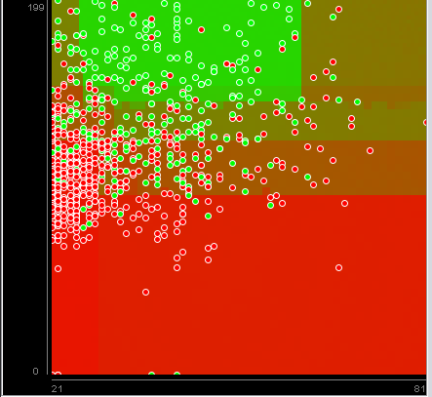
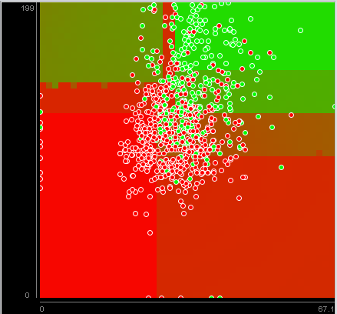
Different attributes different boundaries
Graph A
Graph B
Using the same Tree model we compare Graph A: x:preg y: plas to Graph B: x:mass y: plas and we can clearly see where Graph A has positive in all areas of the top portion of the y axis where the other you can see an absolute negative area on the y axis. The classification boundaries help us understand where attributes have their boundaries and how the computer understands those boundaries.

Slide 11
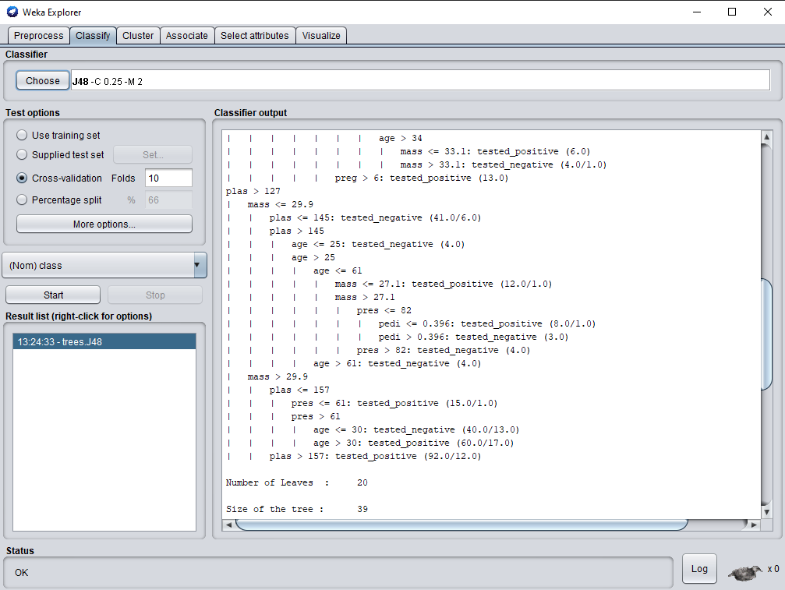
Visualizing Boundaries
Using the visualization tool we are able to visualize the different boundaries each classifier determines. Using the tree example we can visualize how the separate boxes indicate different levels or decisions of the tree.

Slide 12
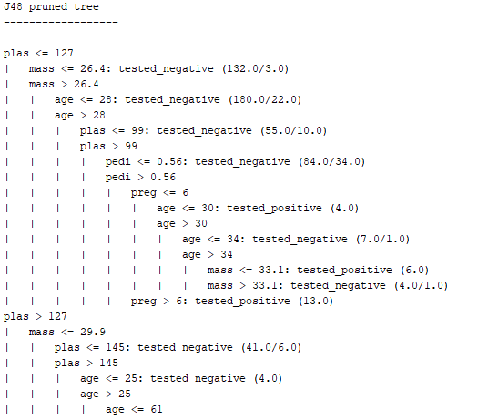
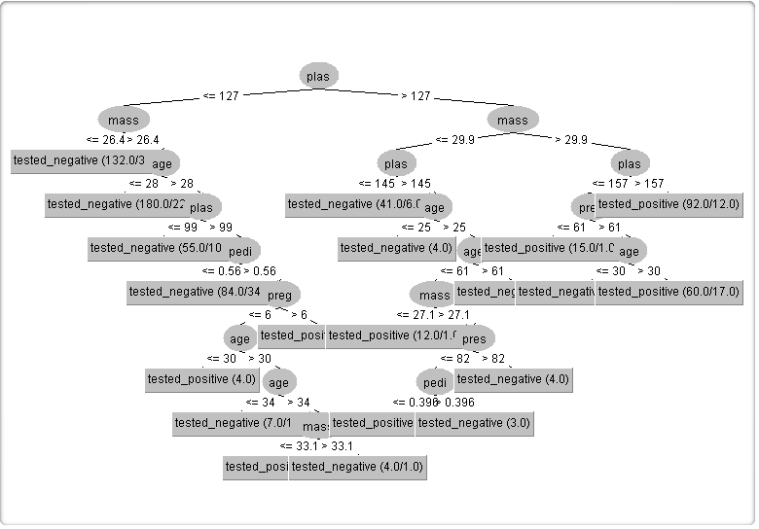
Raw Data vs. Visualization
The application can quickly iterate through data sets and immediately provide raw analytics however the real power of this tool is the visualization provided which provides a far better insight on what the data is predicting. Reading the data in the tree and its levels as below is fantastic however seeing it is something completely different.

Slide 13
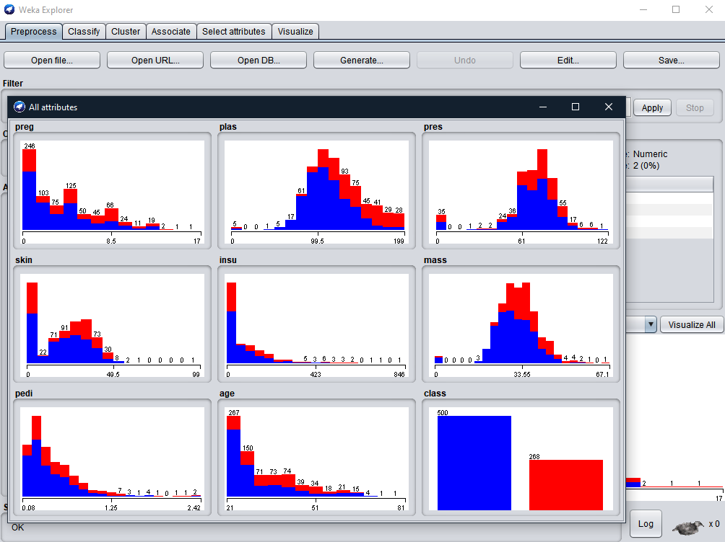
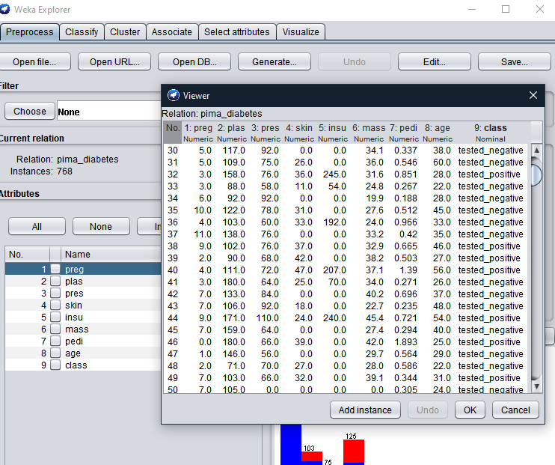
View & Edit
There are multiple way to view the dataset: Graph Visualize
Spreadsheet style

